Slide 1

Design Patterns
-- Vijay Kode

Slide 2
Creational Design Patterns

Slide 3
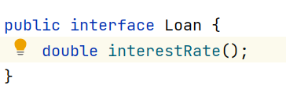
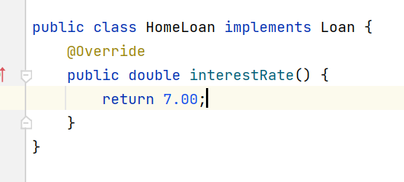
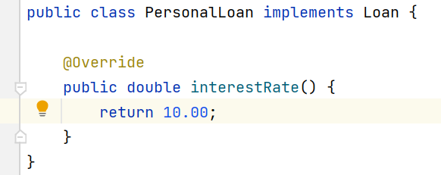
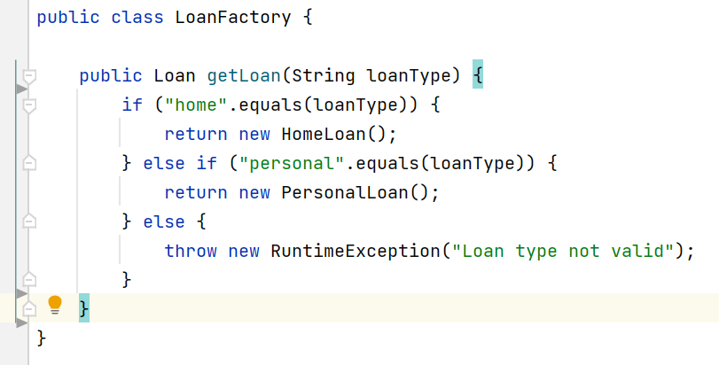


Factory Pattern

Slide 4
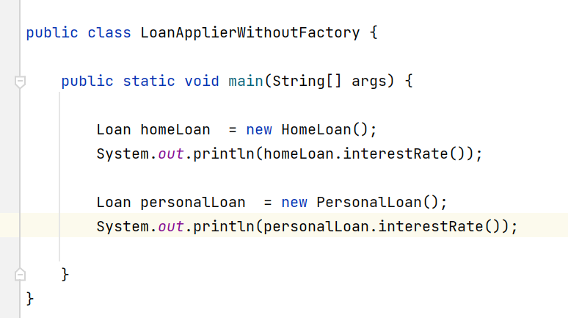
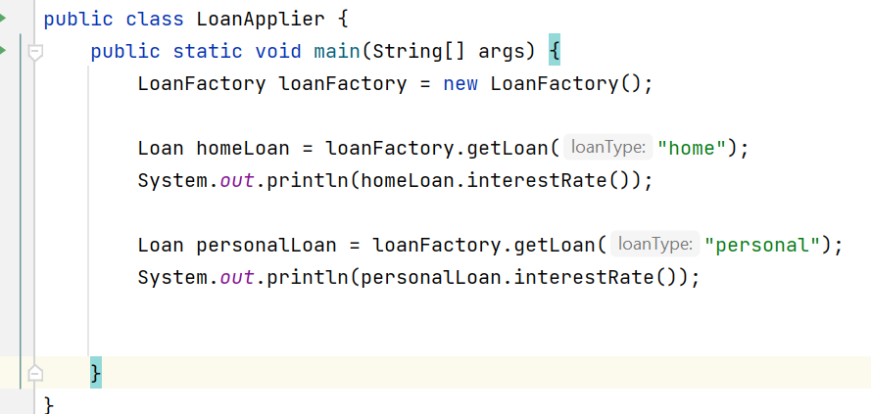
Without Factory design pattern
Directly client takes the burden of creating various objects instead relying on abstraction and results in tight coupling, violates single responsibility.(obj creation + calling loan)
When a new concrete implementation is added say Business loan, again client class need to be modified.
With Factory design pattern
Client is relying on abstraction and it is transferring the burden of creating objects to factory class except the type what it wants. client is just calling, not focusing on creation of objects.
Here we can add one concrete implementation and one more type in factory and just pass business as string in client class(Without modifying).

Slide 5
When to use Factory design pattern
When you don’t know how many concrete implementations comes in future.
When you want to decouple client and application logic.

Slide 6
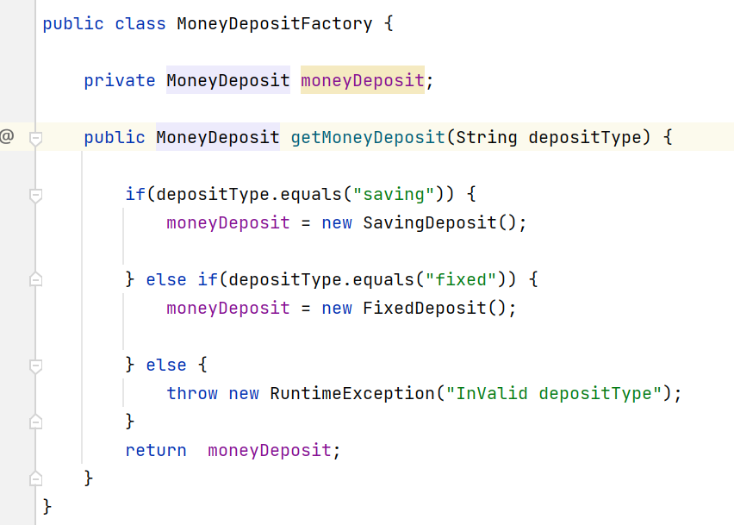
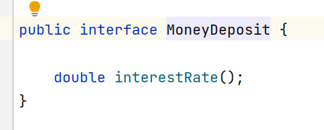
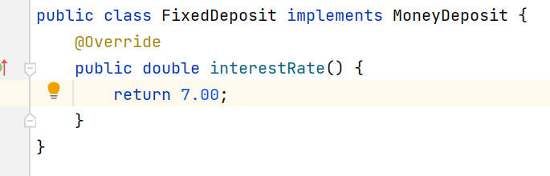
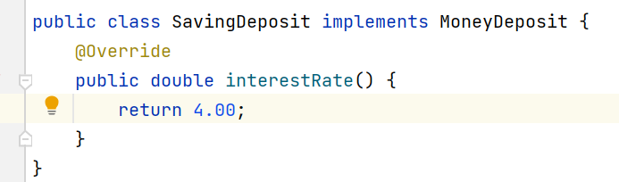
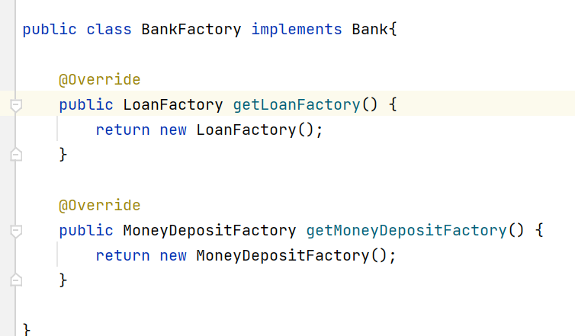
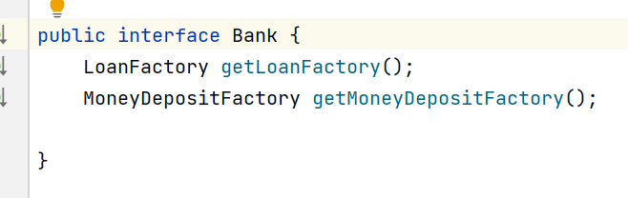


Abstract Factory Pattern

Slide 7
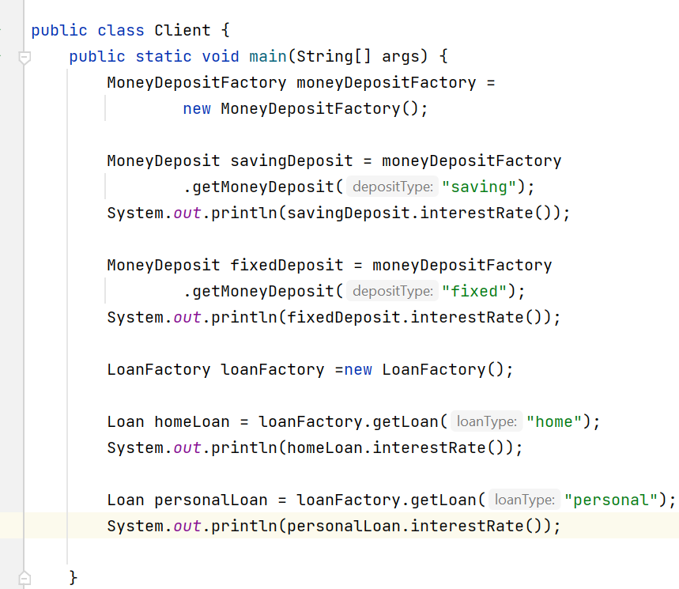
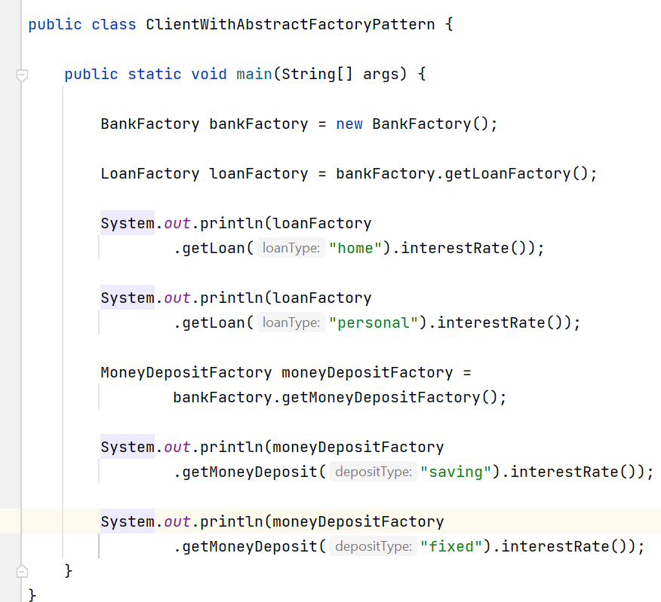
Without Abstract Factory Pattern
With Abstract Factory Pattern

Slide 8
When to use Abstract Factory Pattern
When the system needs to be configured with one of a multiple family of objects which are related.
When the system needs to be independent of how its object are created, composed, and represented.

Slide 9
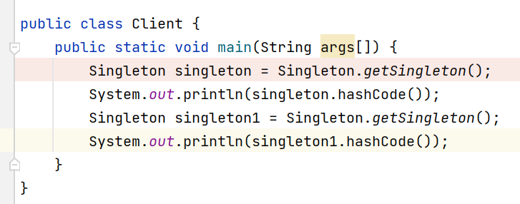
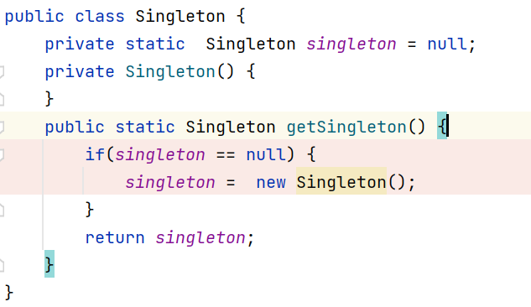
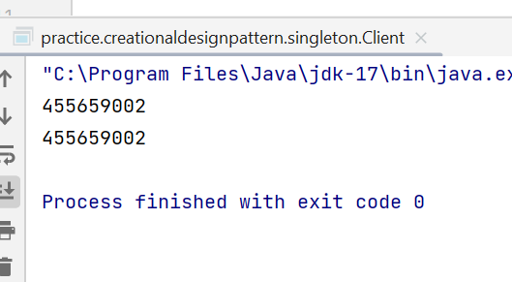
Singleton – Restricts the class to create a multiple object i.e, allows only single object.
Ex: authentication, databases login etc.,
Components:
private no-arg constructor only…
Static instance variable.
Static method which returns the object.

Slide 10
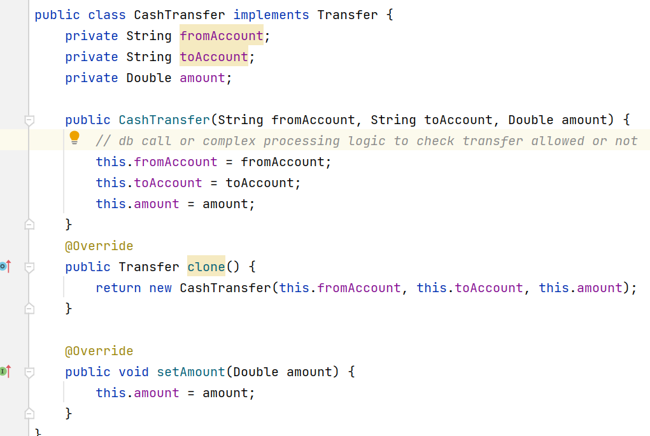
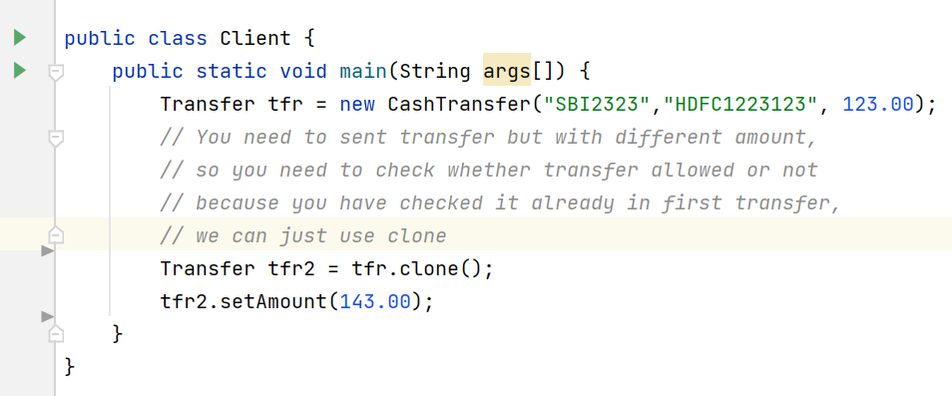
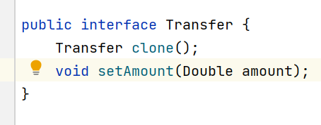
Prototype: copy an existing object rather than create a new instance from scratch, something that may include costly operations.

Slide 11
Builder Pattern

Slide 12
This pattern separates the construction of a complex object from its representation, allowing the same construction process to create different representations. 1. Product The Product is the complex object that the Builder pattern is responsible for constructing. 2. Builder The Builder is an interface or an abstract class that declares the construction steps for building a complex object. 3. ConcreteBuilder ConcreteBuilder classes implement the Builder interface, providing specific implementations for building each part of the product.Each ConcreteBuilder is custmized to create a specific variation of the product. 4. Director The Director is responsible for managing the construction process of the complex object. It collaborates with a Builder, but it doesn’t know the specific details about how each part of the object is constructed.

Slide 13
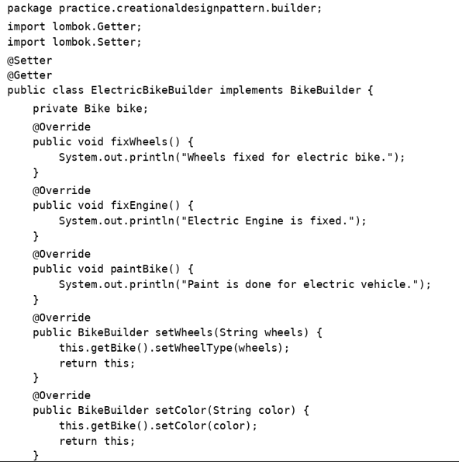
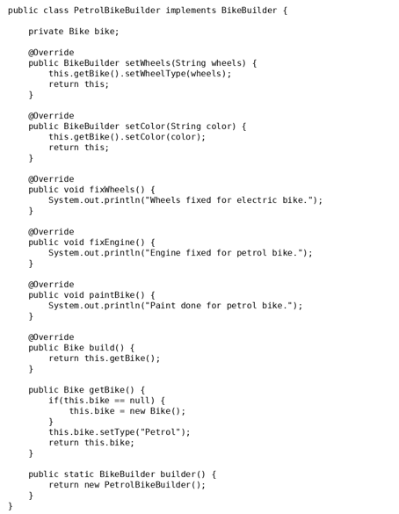
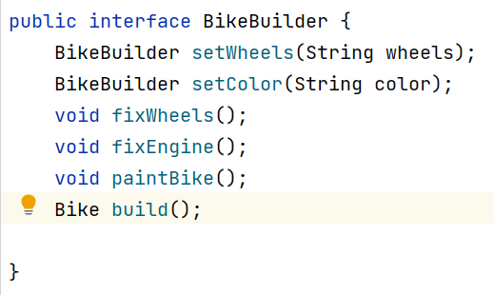
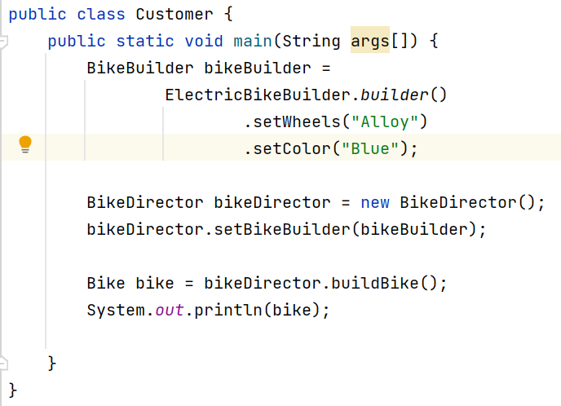
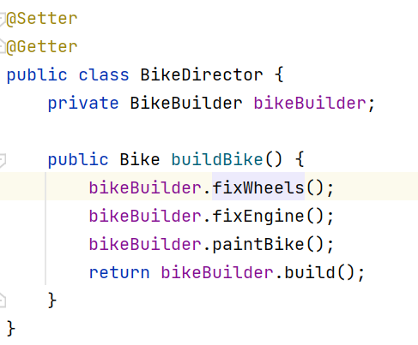
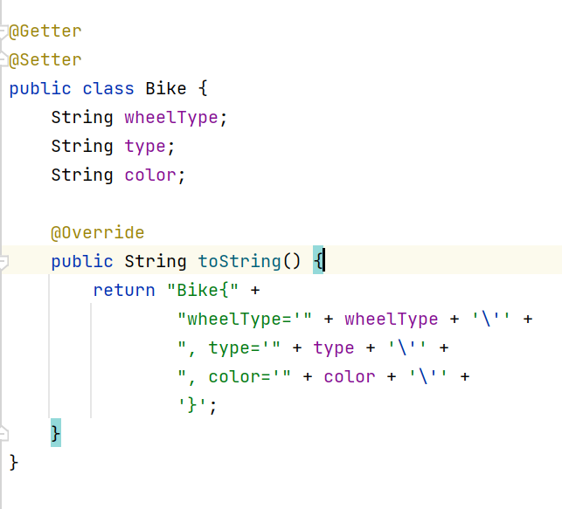

Slide 14
Structural Design Patterns

Slide 15
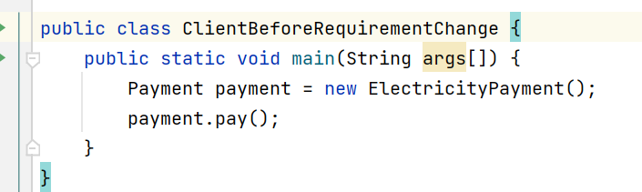
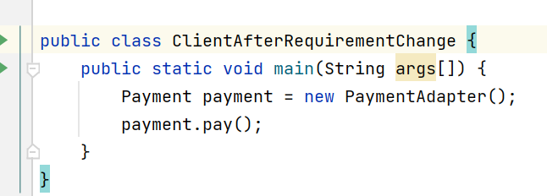
Adapter Design Pattern
The Adapter pattern allows your existing client code to work with new or modified interfaces without altering the client itself. This is crucial when you want to integrate new systems without breaking existing functionality.
See below we just changed implementation class, everything is same.
Assume when there is a requirement change to use another payment interface

Slide 16
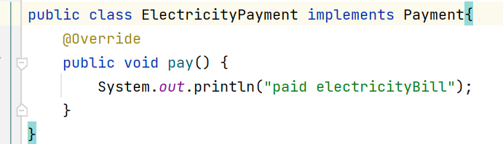
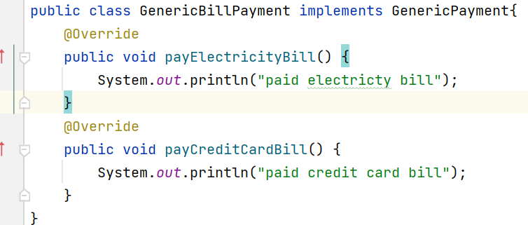
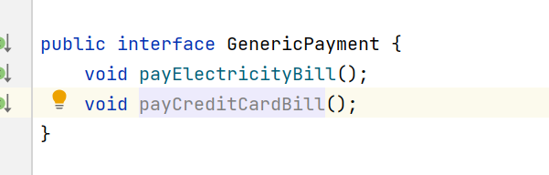
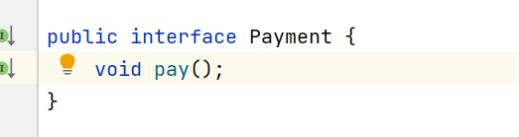
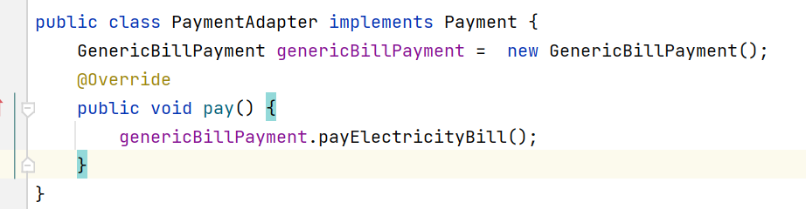



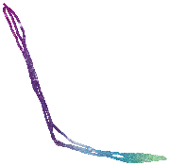

Slide 17
Bridge Design Pattern
The Bridge design pattern allows you to separate the abstraction from the implementation. It is a structural design pattern.
There are 2 parts in Bridge design pattern :
Abstraction
Implementation
Abstraction contains reference of implementation class.
The bridge pattern allows the Abstraction and the Implementation to be developed, independently and the client code can access only the Abstraction part without being concerned about the Implementation part.
The abstraction is an interface or abstract class and the implementer is also an interface or abstract class.

Slide 18
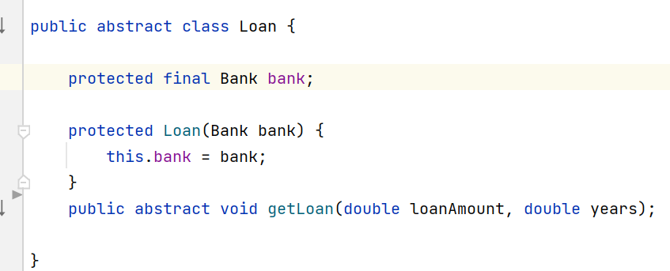
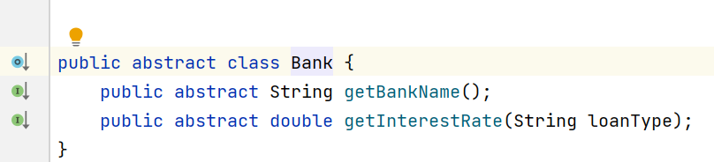
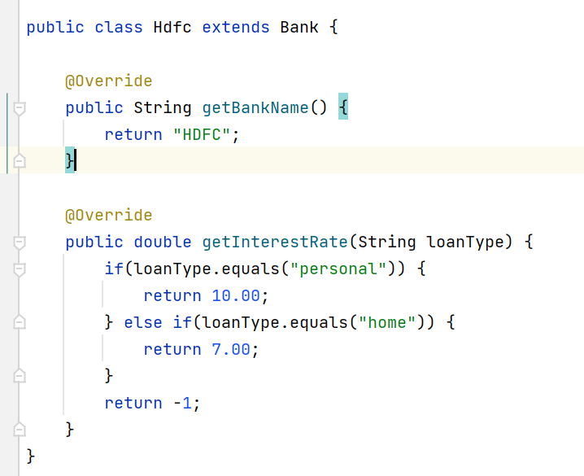
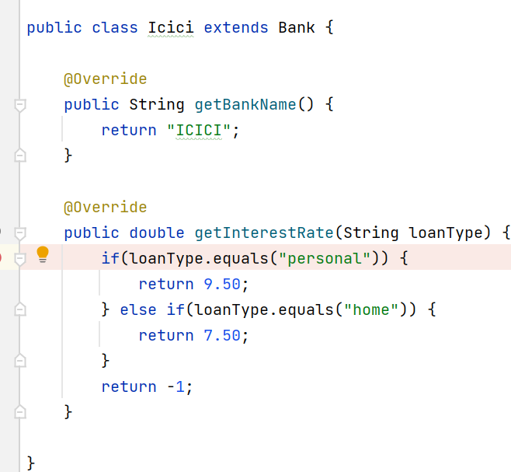
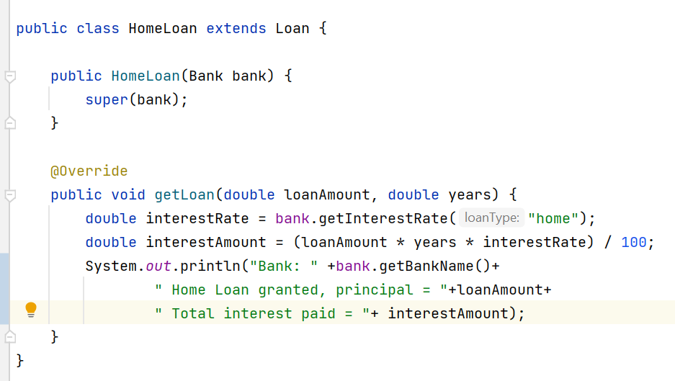
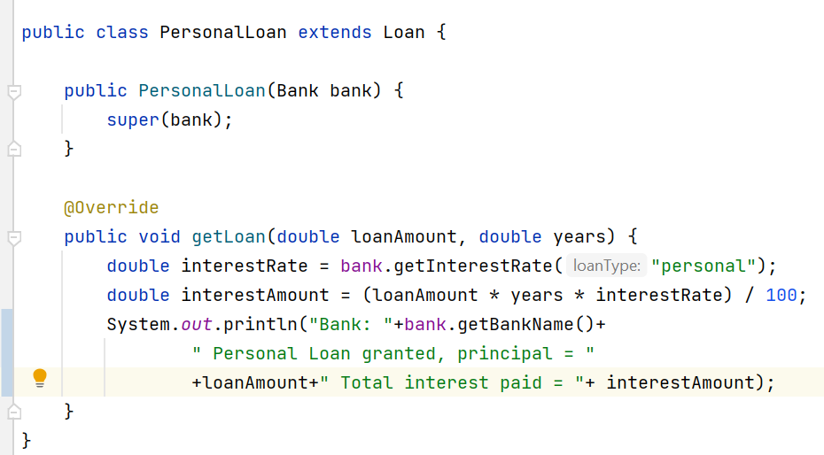
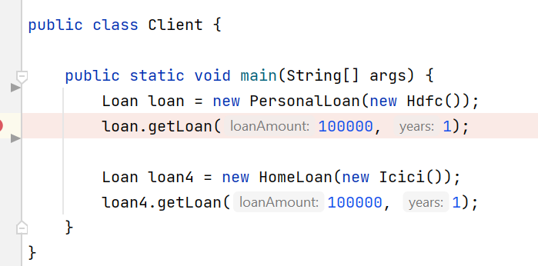






Client just use abstraction without concerned about implementation

Slide 19





Loan
HDFC LoanProvider
ICICI LoanProvider
Personal
Home
Personal
Home
Problem1) :If we want to change HdfcLoan provider, sometimes we need to change its sub classes personal and home.
Problem2): For each bank we need to maintain Personal and Home Loan implementation.

Slide 20
Composite Design Pattern
Composite Pattern is to build a tree structure of objects, where individual objects and composite objects share a common interface. This common interface allows clients to interact with both types of objects without needing to distinguish between them.
Components:
Leaf: Leaf is the individual object that does not have any children. It implements the component interface.
Composite: Complex object holds children , has operations to manage child/leaf objects.
Component: common interface between leaf and composite.
By using component we will access both composite and leaf objects.

Slide 21
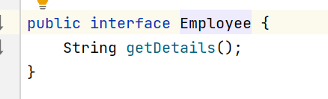
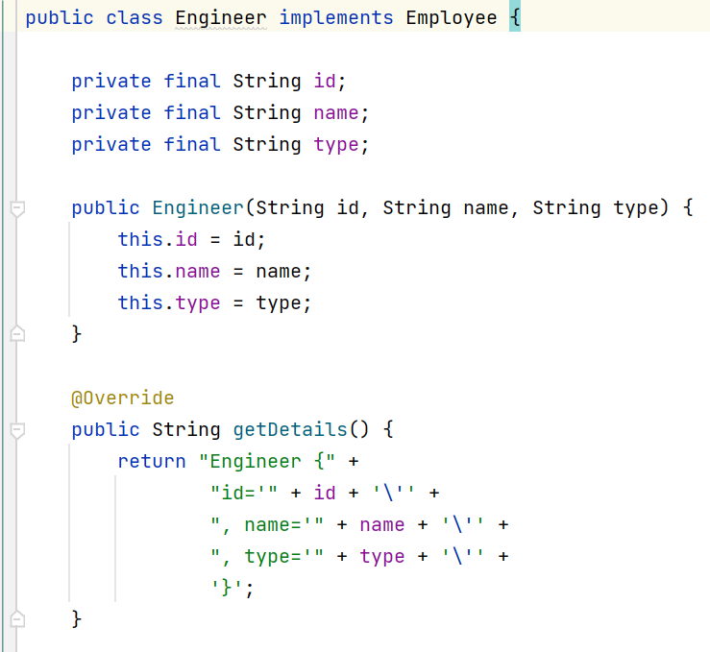
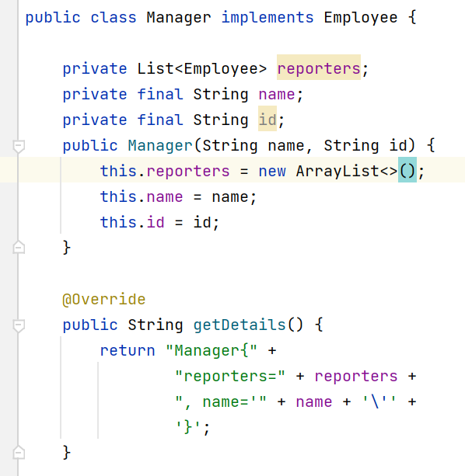
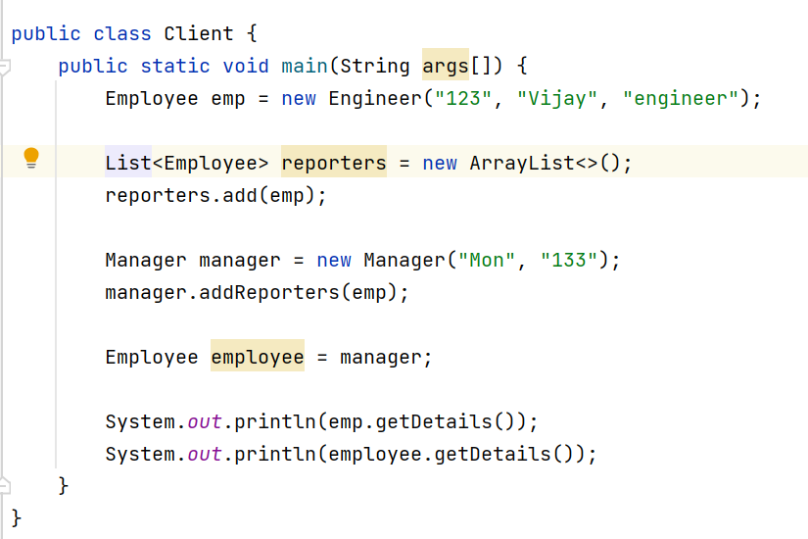



Slide 22
Decorator Design Pattern
The Decorator Design Pattern is a structural design pattern that allows behavior to be added to individual objects dynamically, without affecting the behavior of other objects from the same class.
Components:
Component interface: interface that defines core functionality.
Concrete classes: implements component interface.
Decorator: A abstract class that implements component interface and has a reference of component interface.
Concrete Decorators: implementers of decorator pattern.

Slide 23
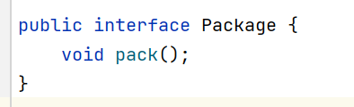
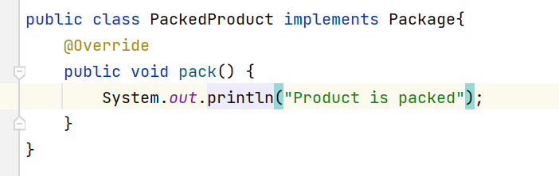
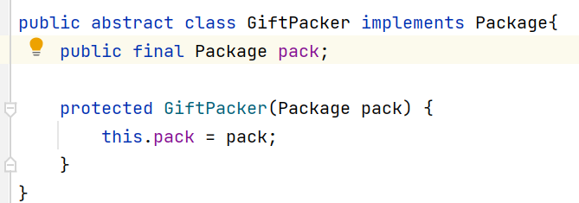
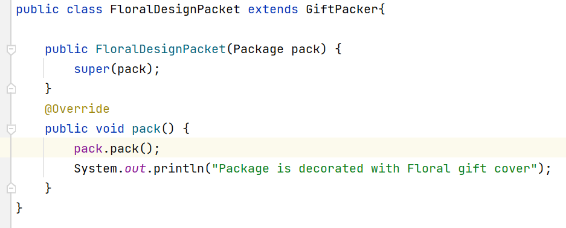
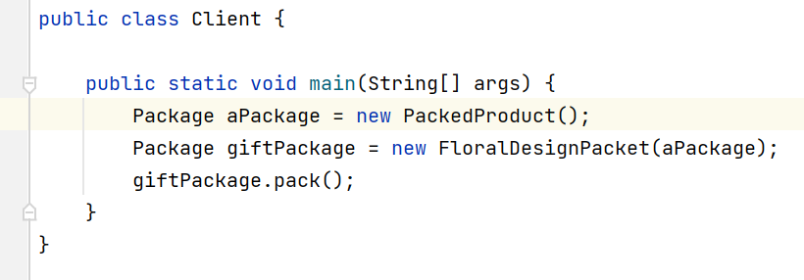





Slide 24

Façade Design Pattern
Facade Method Design Pattern provides a unified interface to a set of interfaces in a subsystem. Facade defines a high-level interface that makes the subsystem easier to use.
A Facade to decouple the subsystem from clients and other subsystems, thereby promoting subsystem independence and portability.
Ex: if any subsystem is replaced by another endpoint,
we can do this redirection in façade, without changing
client code

Slide 25













Slide 26
Flyweight Design Pattern

Slide 27
The Flyweight design pattern is a structural pattern that aims to minimize memory usage and improve performance by sharing objects that have similar or identical states. When to use : There is need to creating number objects that have common props with memory optimization. Concepts: Intrinsic state of an object: When object has same common properties, we say it is in intrinsic state or shared state. Extrinsic state of an object: This is the state where the object properties are different than common properties. Since object creation is large numbers requires more memory, we will create object with common properties (intrinsic state) and while at run time we will change the properties if required( extrinsic state), Components: Flyweight interface Concrete classes that implement Flyweight interface Factory to manage objects of concrete classes

Slide 28







Slide 29
Behavioral Design Pattern

Slide 30
Chain of Responsibility

Slide 31
Chain of Responsibility Pattern allows an object to send a request to other objects without knowing who is going to handle it.
This pattern is frequently used in the chain of multiple objects, where each object either handles the request or passes it on to the next object in the chain if it is unable to handle that request.
Example: lets take example of customer care, have several level to handle the request based on criticality. If one person not able to solve, the request will be forwarded to next level and we exactly don’t know at which issue could be resolved. In this Chain of Responsibility Principle is used.
Simply put, when you have several handlers to handle the same request and you don’t know which handler handles it and you want decoupling between sender and handler.

Slide 32











Slide 33
Command Design Pattern

Slide 34
The Command Pattern encapsulates a request as an object, allowing for the separation of sender and receiver.
Commands can be parameterized, meaning you can create different commands with different parameters without changing the invoker.
It decouples the sender from the receiver, providing flexibility and extensibility.
The pattern supports undoable operations by storing the state or reverse commands.
Components:
Command (I) : It sets the contract for all command. It contains execute() or any which is to execute the command.
.Receiver(I): it defines the type of actions that system performs or supports. It is implemented by concrete classes.
Invoker(I): It holds the reference of command and executes the command. (invokes execute())

Slide 35








Slide 36
Observer Design Pattern

Slide 37
The Observer Design Pattern is a behavioral design pattern that defines a one-to-many dependency between objects. When one object (the subject) changes state, all its dependents (observers) are notified and updated automatically. Components: Observer is an interface which defines the contract that every concrete observer has to implement. Subject is also an interface which defines contract for concrete subjects, provides methods for adding removing updating observers. Note: Subjects are the objects that maintain and notify observers about changes in their state, while Observers are the entities that react to those changes. Observer pattern aims at decoupling Observers and Subject. Subject need not know about observer works. Subject and Observers maintain one to many relationship

Slide 38






Slide 39
Mediator design Pattern

Slide 40
To centralize communication between various components or objects in a system. This promotes loose coupling by preventing direct interactions between components, instead of having them communicate through the mediator, facilitating better maintainability and flexibility in the system architecture Components: 1. Mediator The Mediator interface defines the communication contract, specifying methods that concrete mediators should implement to facilitate interactions among colleagues. 2. Colleague Colleague classes are the components or objects that interact with each other. They communicate through the Mediator, and each colleague class is only aware of the mediator, not the other colleagues. 3.Concrete Mediator Concrete Mediator is a specific implementation of the Mediator interface. 4. Concrete colleague Concrete Colleague classes are the specific implementations of the Colleague interface.

Slide 41


















Slide 42
State design Pattern

Slide 43
The State design pattern is a behavioral software design pattern that allows an object to alter its behavior when its internal state changes. Encapsulates states as objects. This pattern is particularly useful when an object’s behavior depends on its state, and the state can change during the object’s lifecycle. Components: 1) Context: The Context is the class that contains the object whose behavior changes based on its internal state. It maintains a reference to the current state object . 2) State Interface or Base Class The State interface or base class defines a common interface for all concrete state classes. 3) Concrete States: Concrete state classes implement the State interface or extend the base class. Each concrete state class encapsulates the behavior associated with a specific state of the Context.

Slide 44










Slide 45
Strategy pattern

Slide 46
The Strategy Design Pattern defines a family of algorithms or strategies, encapsulates each one, and makes them interchangeable, allowing clients to switch algorithms dynamically without altering the code structure. 1. Context A class or object known as the Context assigns the task to a strategy object and contains a reference to it. 2. Strategy Interface An abstract class or interface known as the Strategy Interface specifies a set of methods that all concrete strategies must implement. 3. Concrete Strategies Concrete Strategies are the various implementations of the Strategy Interface. Each concrete strategy provides a specific algorithm or behavior

Slide 47










Slide 48
Template Pattern

Slide 49
The Template Method Design Pattern is a behavioral design pattern that provides a blueprint for organizing code, making it flexible and easy to extend. With this pattern, you define the core steps of an algorithm in a method but allow subclasses to override specific steps without changing the overall structure. Components: 1) Abstract Class (or Interface): This is the superclass that defines the template method. It provides a skeleton for the algorithm, where certain steps are defined but others are left abstract/ 2)Template Method: This is the method within the abstract class that defines the overall algorithm structure by calling various steps in a specific order. It’s often declared as final to prevent subclasses from changing the algorithm’s structure. 3)Abstract Methods: These are methods declared within the abstract class but not implemented. 4)Concrete Subclasses: These are the subclasses that extend the abstract class and provide concrete implementations for the abstract methods defined in the superclass.

Slide 50




Slide 51
Visitor Pattern

Slide 52
Visitor design pattern makes it possible to add new operations to preexisting classes without changing them. Components: Visitor Interface: This interface declares a visit method for each type of element in the object structure. Each method is designed to handle a specific element type. Concrete Visitor: This class implements the Visitor interface and provides the specific behavior for each visit method. It contains the logic for the operations that need to be performed on the elements. Element Interface: This interface defines an accept method that takes a visitor as an argument. This method allows the visitor to visit the concrete elements. Concrete Elements: These classes implement the Element interface and represent the various types of objects in the structure. Each concrete element defines how it accepts a visitor by calling the corresponding method on the visitor.

Slide 53







